Slide 1
Containers 101.1
Project Photon OS, Docker, and More!

Slide 2
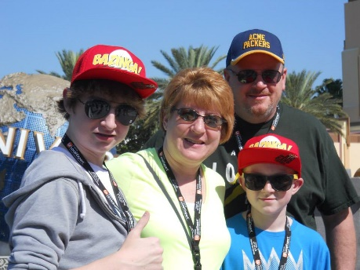
Mike Nelson
WI-VMUG Co-Leader
MVP, CTP, vExpert, MAA
@nelmedia

Slide 3
What about Windows?
Who manages containers? With What?
Who has used some form of container technology?
What is Docker?
What are MicroServices?
Is it only about DevOps?
Why would you use containers?
Who’s heard about Project Photon OS?
Who’s heard about Project Bonneville?
What apps can run in containers?
Where can containers be run?

Slide 4

1964
IBM CP-4
IBM z/VM
IBM System/360
Notes:
1964 IBM CP-40 System 360

Slide 5
A (really) Brief History of Containers
1960’s
Mainframe
1979
Chroot in Unix V7
1990-2000+
BSD Jails, Solaris Zones
Linux Vserver
2006
Process Containers
2008
LXC
2013
Docker
2014
Rocket & more…
MicroServices
2015

Slide 6
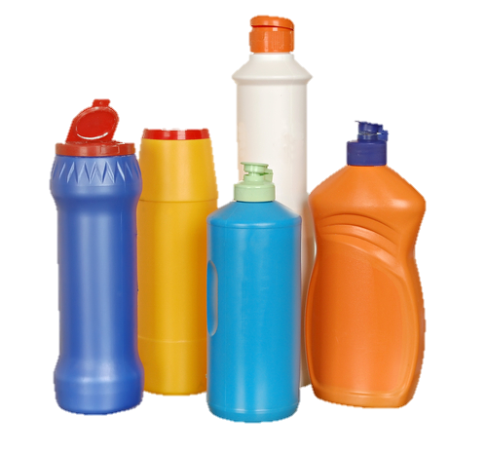
What are containers?
Containers are Operating System-level Virtualization.
Containers encapsulate applications into individual isolated environments on a shared operating system with their own processes, network, binaries, and libraries.

Slide 7
It’s about the applications.
Containers:
Are not just for DevOps anymore!
“Throw-away” components
Deploy really, really, really fast
Are simple to complex to build
Are extremely compact & lightweight = very high density
Portable. Well, kinda.
Have an “Open” Standard. Well, kinda.
Management is simple, but mostly CLI for now
Have a massive EcoSystem – like really, really big.

Slide 8
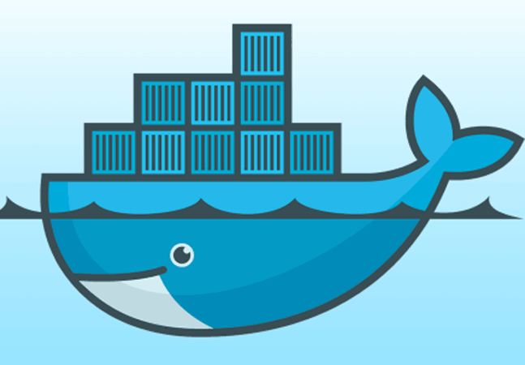
What is docker?
Docker is an open platform container technology. It is a management, api, host, and packaging platform for containers.
Docker has a huge ecosystem of applications & services that allow for growth, scale, resiliency, and redundancy.
NOT THE ONLY GAME IN TOWN ANYMORE

Slide 9
Hypervisor Architectures
Hardware
Hypervisor
Guest 1
Guest 2
Hardware
Hypervisor
Guest 1
Guest 2
Host OS
Type 1
Type 2

Slide 10
VM vs Containers Architecture
App A
App B
Container
App A
App B
App A¹
App B¹
App B²
App C
VM
Bins / Libs
Bins / Libs
Hardware
Hypervisor
Guest 1
Guest 2
Host OS
Bins / Libs
Bins / Libs
Hardware
Container Engine
Host OS

Slide 11
OS Cost
OS Cost
Density
Density
Virtual Machine
Container

Slide 12
Density
1 to 1K+ on single host
DockerCon2015 – 2500 web servers running on Raspberry Pi2
Performance - Lightweight
<50ms start / stop
Lower cost of OS
Agnostic – Hardware & Content
Separation of Duties
Portability
Within kernel revisions*
Future OS inter-operability
Live migrations now possible with CMT
Isolation*
Why Containers Matter

Slide 13
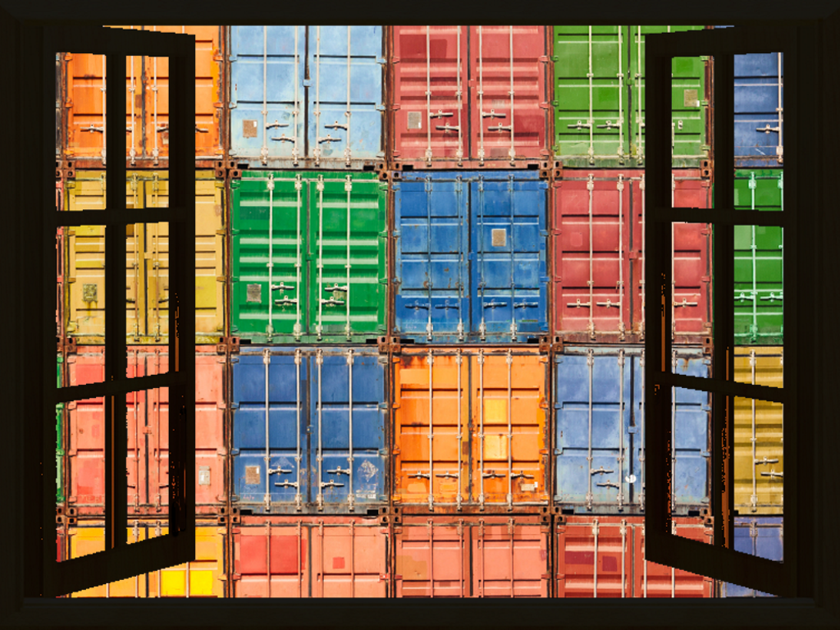
Opening Windows to Containers
Linux-
Azure support for Linux Containers
Windows Docker Toolbox (OS X, WIN)
Windows-
Windows Docker Machine (VirtualBox)
Windows Containers
Hyper-V Containers
PowerShell for Containers
Look for portability between platforms

Slide 14
Microvisor Architecture
Guest 1
Guest 2
Microvisor
Lightweight Linux
Hardware

Slide 15
Project Bonneville
“Native container solution for VMware’s hypervisor”
Docker daemon with custom VMware code & drivers
Approach:
The container is a VM
The VM is a container
The container is an x86 hardware virtualized VM
Integrates with Project Fargo – Instant Clones
Provision VM’s from ROM image with (theoretical) zero footprint
Can run containers of any kernel version of any OS (again, theoretically)
Secure & isolated (likely?)
Portable

Slide 16
Project Bonneville
“Native container solution for VMware’s hypervisor”
Docker daemon with custom VMware code & drivers
Approach:
The container is a VM
The VM is a container
The container is an x86 hardware virtualized VM
Integrates with Project Fargo – Instant Clones
Provision VM’s from ROM image with (theoretical) zero footprint
Can run containers of any kernel version of any OS (again, theoretically)
Secure & isolated (likely?)
Portable

Slide 17
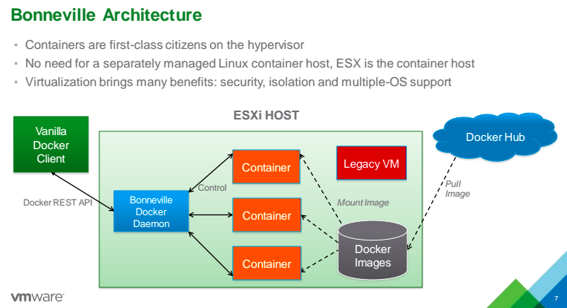

Announced June 2015 with AppCatalyst
Notes:
Ben Corrie Sr Staff Engineer
AppCatalyst – free desktop hypervisor for dev’s

Slide 18
Project Photon OS
Photon Controller
Multi-Tenant
API Driven
HA
Open Source
Photon Machine
Photon OS
Pico build of Linux (with Yum!*)
ESX core Microvisor
~20MB boot
Notes:
Yum compatible “tdnf”

Slide 19
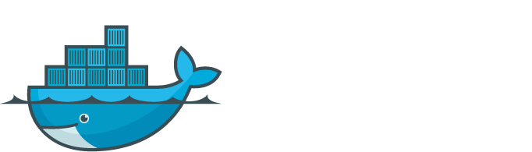
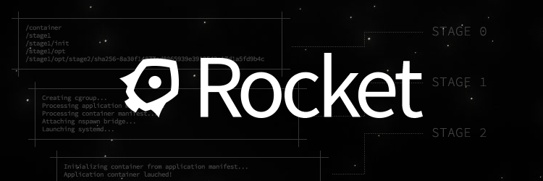
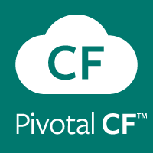
Project Photon OS – Compatible Containers
Cloud Foundry Garden
Notes:
Rocket – CoreOS, makers of Tectonic (enterprise kubernetes) & Quay (container registry/repo)
CF Garden’s container technology is provided by Warden, which was written by Pieter Noorduis of VMware.
Warden provides a service for managing a collection of containers and defines a protocol for clients to send requests to and receive responses from the server.

Slide 20
Project Photon OS – Where Can It Run?
Local
Client Hypervisor (Fusion, Workstation)
vSphere ESXi
Cloud
Azure*
vCloud Air
Google Cloud*
AWS*

Slide 21
vCenter
ESXi
Photon OS
Bonneville
Unified Hybrid Platform
Photon Platform
Photon Controller (open source)
Microvisor
Photon OS
Bonneville
IT Driven
Feature set of vMotion, HA, etc.
All Apps
Highly Compatible
Containers ONLY
No Single Point of Failure
High Scale & Density
API Driven

Slide 22
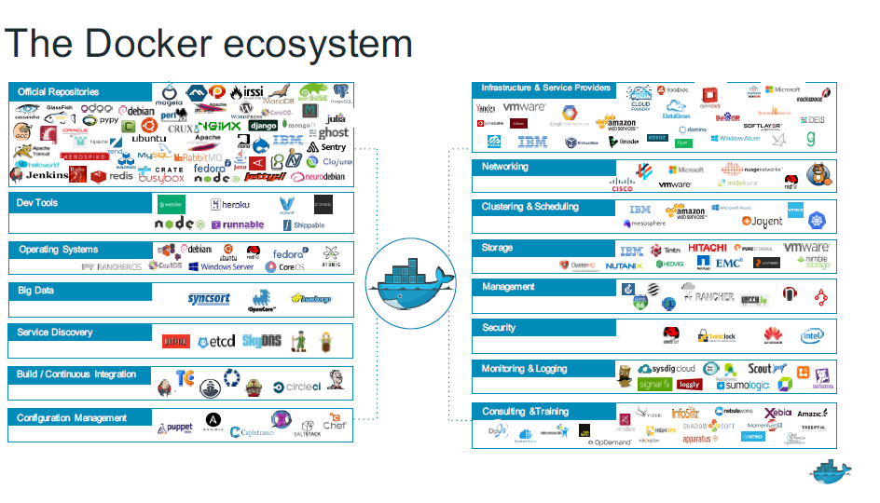

Slide 23
Q&A
But first….
March 31st – XenAppBlog.com Virtual Expo Presentation
“Microsoft Application Containers for Geeks”
DEMO

